Slide 1
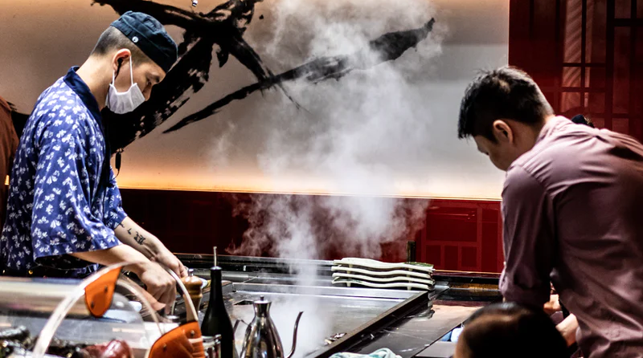

Bringing Teppanyaki to Life
Team #47

Slide 2



Objectives
KPIs
1. Develop a marketing plan to drive increase usage of delivery and curbside pickup services.
Profit post COVID-19
Number of Delivery
2. Identify market potential in home dining experiences to develop diversified revenue portfolio.
Number of Omakase
Number of Reservations
3. Facilitate employee training and education on COVID-19 health regulations, prioritize team morale, and explore new career paths.
Number of Employees
Restaurant Penetration
Phase 1
Phase 2
Phase 3
Delivery & Pick-up
Omakase
Reopening Plans
Aug - Sep 2020
Fall 2020
Fall 2020 & Beyond
Rebrand for quality and experience first. Simplified menu optimized for delivery and curbside pickup. Provide chefs with training on omakase service.
We bring THG to your home through our new private teppan-chef home service. Celebrate your special occasions at the comfort of your home.
Elevated dining experience with private rooms available and compliance with health regulations post COVID-19.

Slide 3
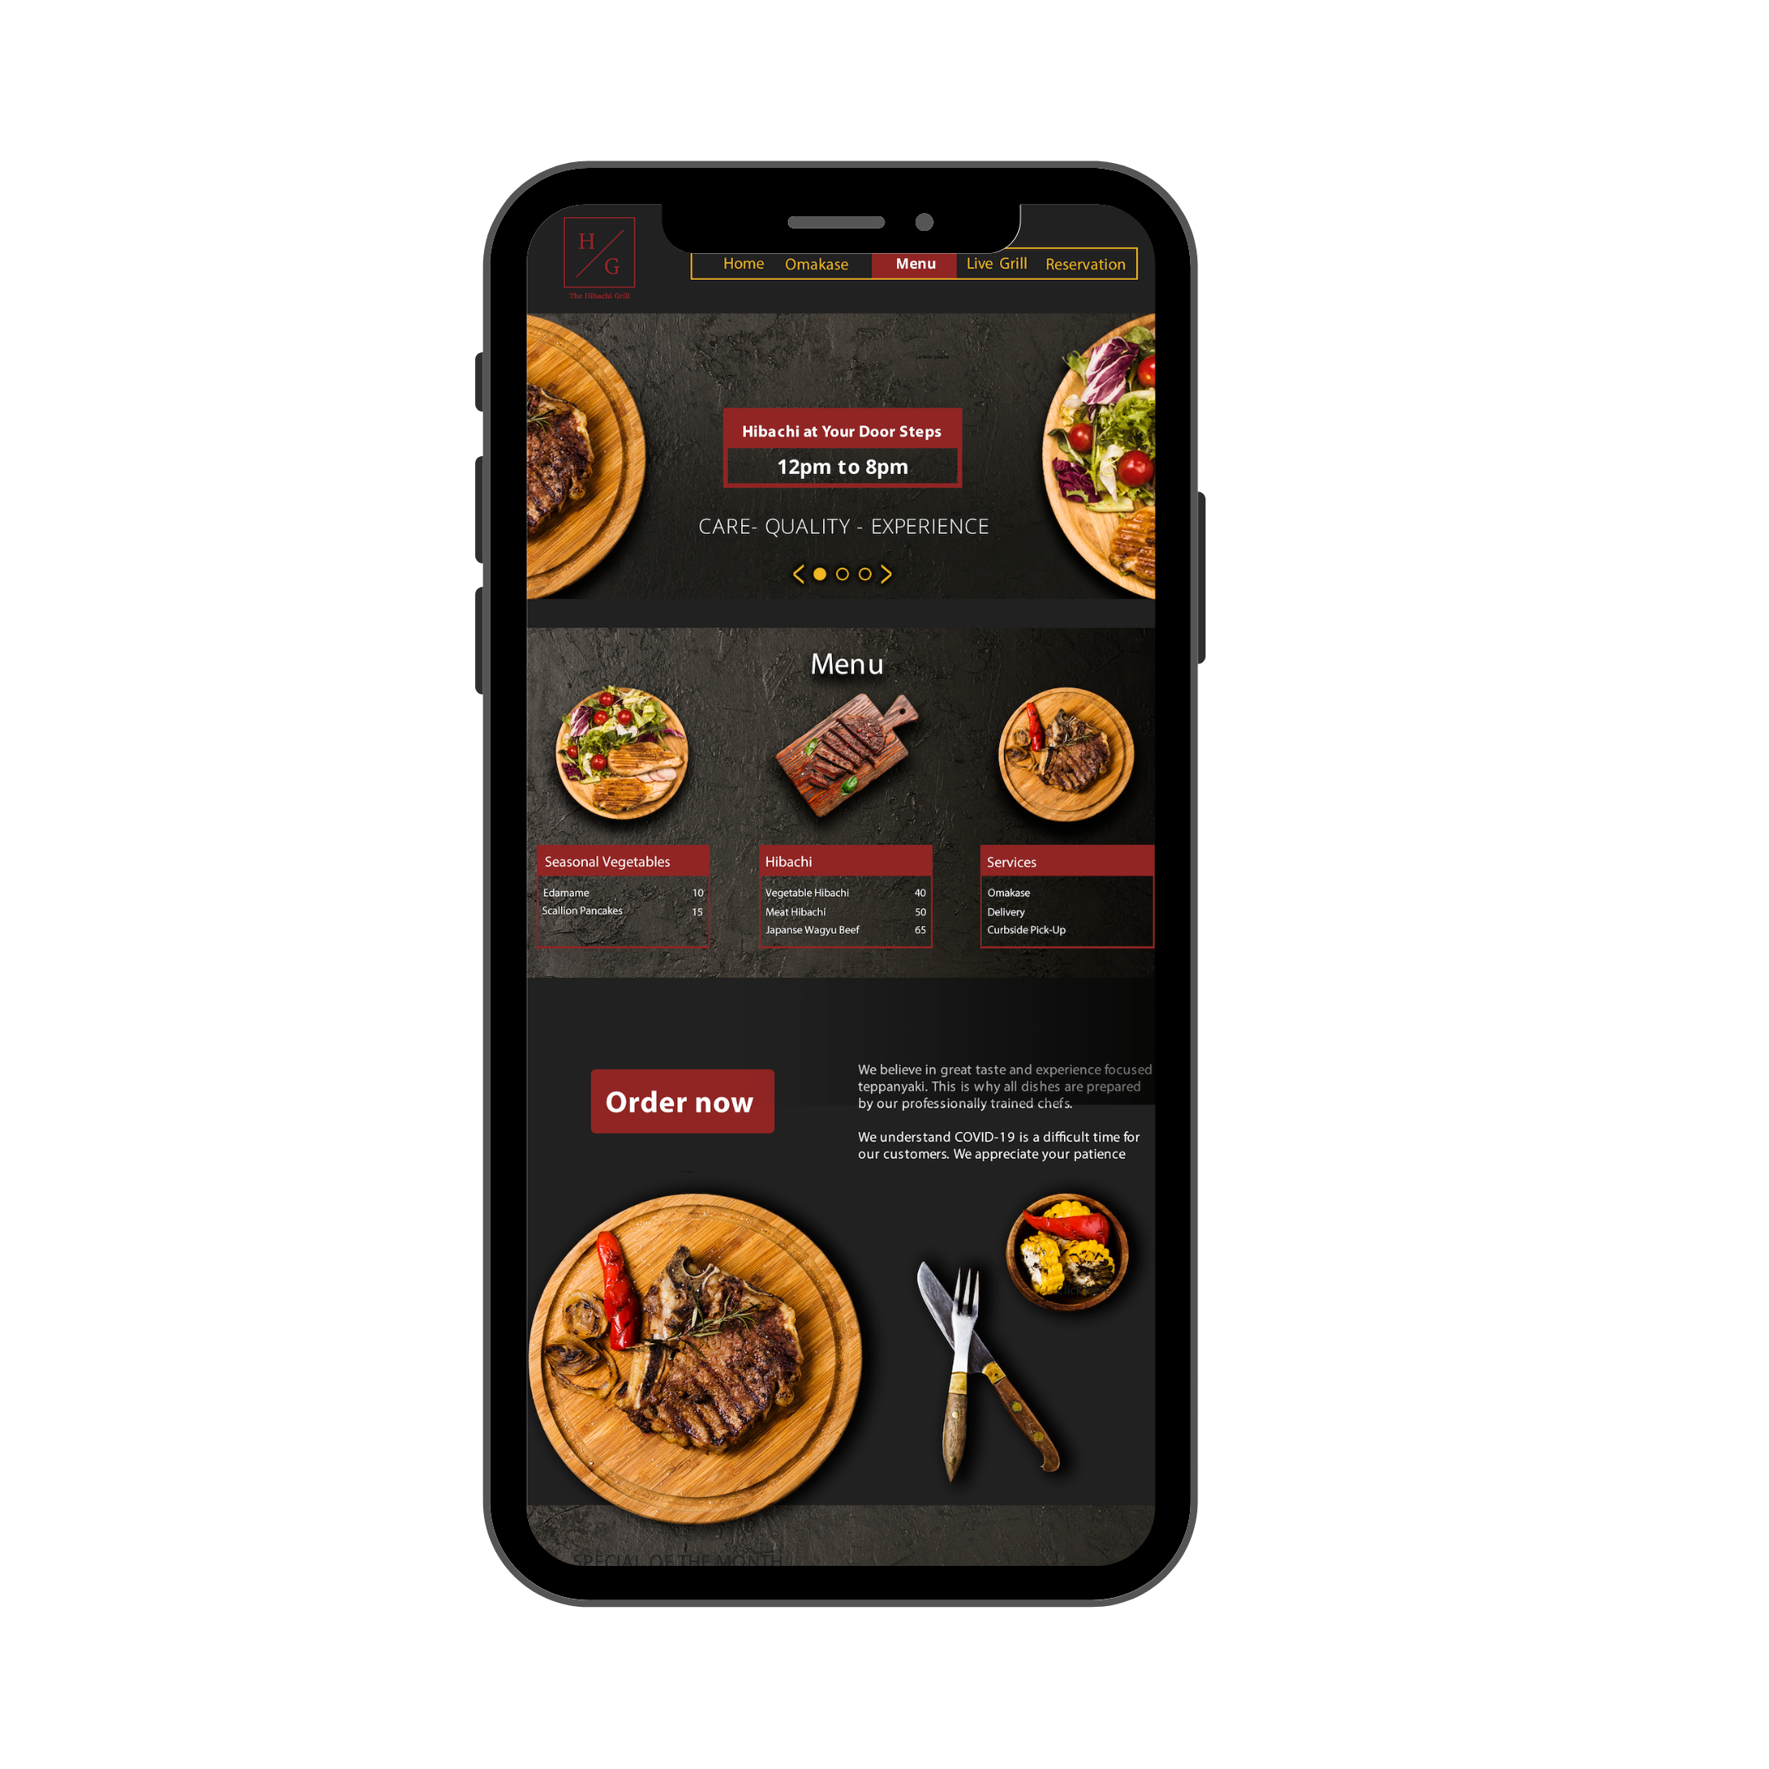






Enhanced digital content appeals to consumer needs and promotes an experience-driven teppanyaki brand.
Delivery & Pick-Up
Phase 1
Phase 2 + 3
Digital Experience
The
Hibachi
Grill
Reservation
Launch new website with CRM functions to improve marketing communication.
Place a reservation when dine-in option is available for phase 3.
Our Mission
Live Grill
Omakase
Watch your food being prepared from the moment it is ordered to the time it arrives within your home.
Passionate about experience-driven teppanyaki, elevated through our digital presence, we aim to improve our respective communities through our class of trade.
Enjoy personalized dishes prepared by our professionally trained teppanyaki chefs.
Pick-Up / Delivery
Storytelling
Pick what is the easiest for you. All-in-one website to place an order whether it is pick-up or delivery.
Highlight the stories of our chefs, waiters, and hosts and their culinary journey.

Slide 4
Private Chef Service: Market Description and Opportunity
Omakase
Households in Philadelphia
Value Proposition
Total of 600,000 households in Philadelphia
(Source: U.S. Census)
Median monthly household income: $2700 after-tax.
Product caters to the top 50% of the city households. (Avg. price $400)
Market penetration goal: 0.5% to 1%
Projected annual profit at goal: $187k to $374k.
See Appendix for detailed cost structure of the product.
Consumers: Celebrate their special occasions and experience authentic teppanyaki at the comfort of their home.
Chefs: Create employment opportunities, paired with comprehensive training with stipend, and competitive salary.
THG: Reinforce our mission of delivering experience-driven teppanyaki while generating positive cash flow.
0.01%
300
300k
50%
Household income in the top 50%
Private chef bookings needed to break even
Go-To-Market Strategy
1
Provide professional training for chefs on Japanese etiquette, culture, history, and home cuisines.
2
Obtain certifications including Pennsylvania Food Safety Training, Pennsylvania Food Handler, and Personal Certified Chef.
3
Leverage small business ad grants to advertise Omakase on Facebook, Instagram, and Google Search, as well as private chefs booking sites.
Notes:
Omakase - can charge higher price for meal, use finest ingredients + skills, easier for them to plan food costs when purchasing

Slide 5


Mid-career professionals are seeking new at-home experiences
Profile
Most Used Social Media
Omakase
COVID-19 Impact
Age: 33 years
Location: Philadelphia
Experiment new brands
Job: Consultant
Gender: Female
More than 75% of consumers have experimented with a different shopping behavior during the crisis, including trying new brands. (Source: McKinsey)
What They Look For
Instagrammable
Ethical Sourcing
Rise of at-home travel
“I need new experiences that lets me see the bigger world, take new photos for my feed, and meet my friends for a nice meal.”
Consumers are looking for ways to engage in travel-like experiences. Airbnb launched online experiences and famous landmarks now have virtual tours available.
Personalized Service
Exclusivity
Purchase Behavior
Desire for social interactions
$80
Search interest in “watching together” is up over 4X since early January. Consumers are seeking for new activities to do with their respective families. (Source: Google)
$40
$20
Notes:
Phase 2 - rise of consumer interest in enteratinment

Slide 6
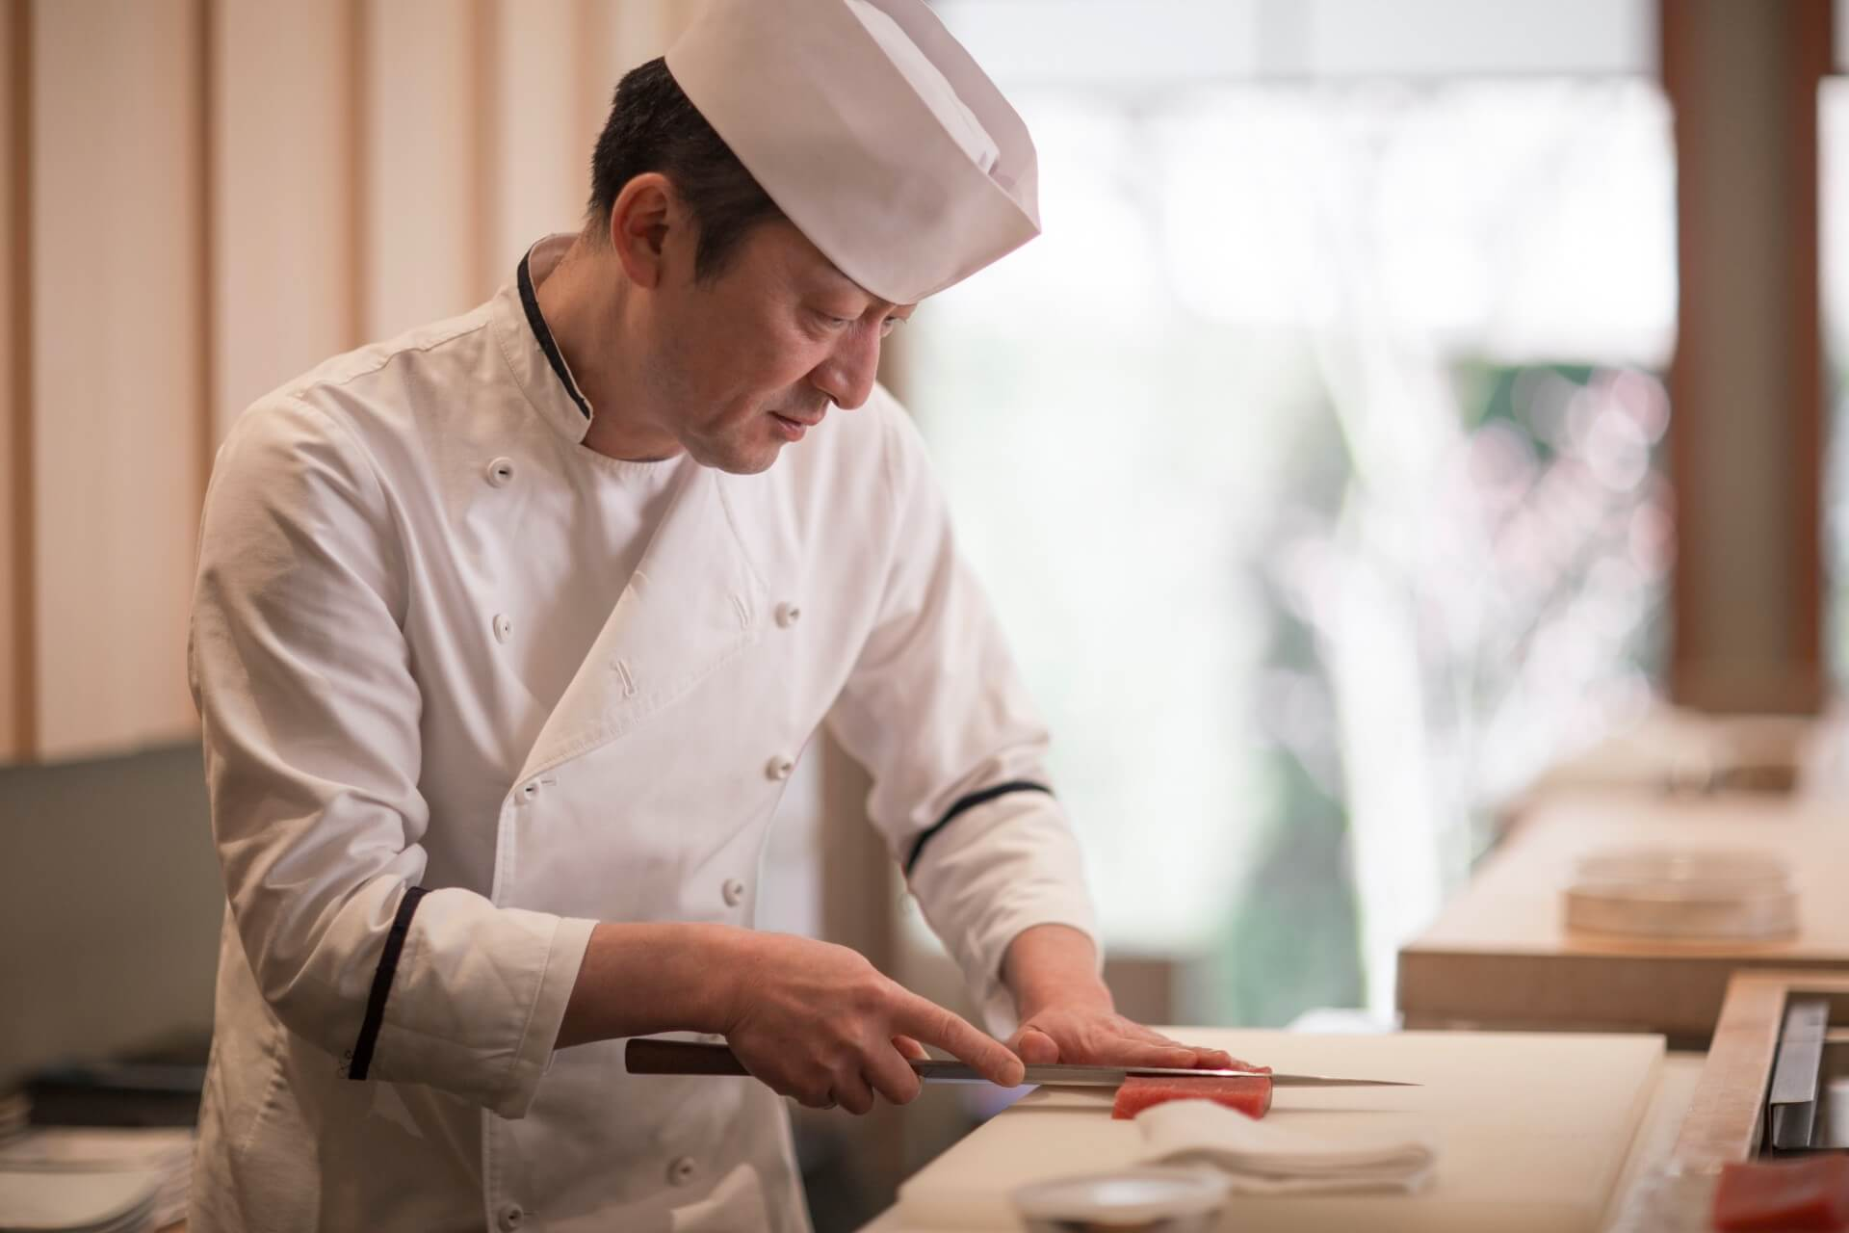
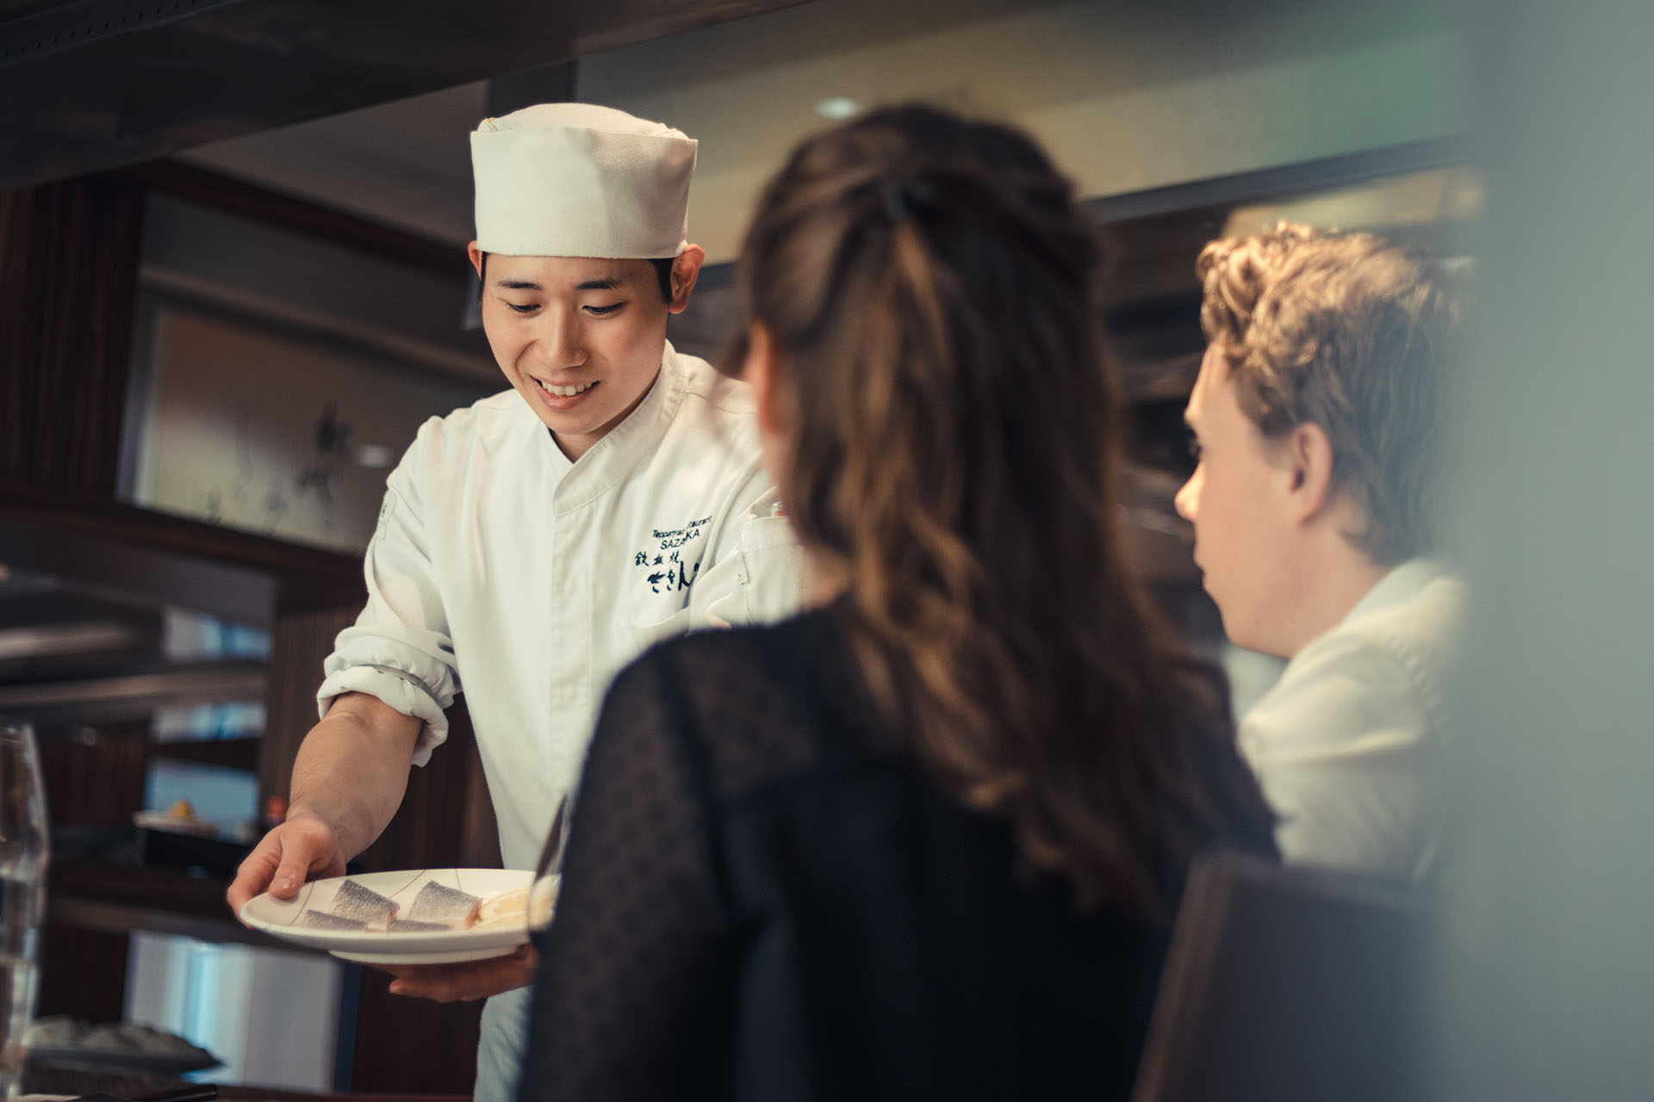
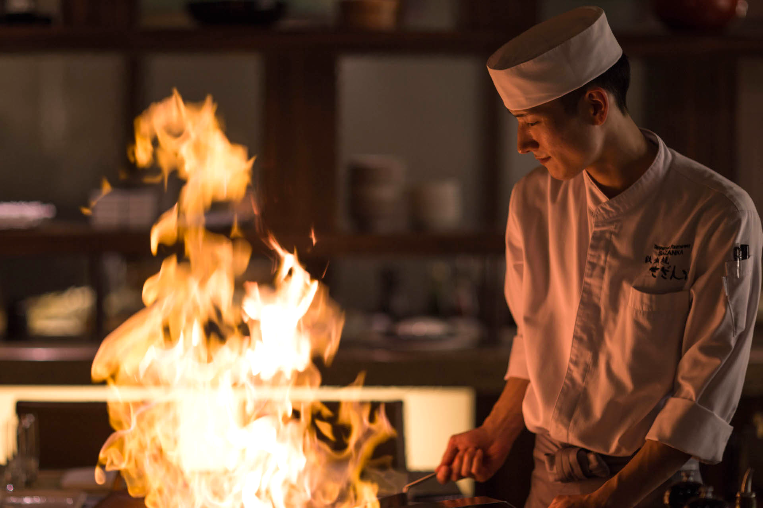
Omakase is a private teppanyaki chef service that brings Japan to your home
Omakase
Impact
130
avg. profit per omakase
8+
jobs retained
Quality
Care
Experience
With the freshest and most exclusive ingredients using bincho-zumi, a smokeless charcoal, we can bring the authentic teppanyaki experience to your home.
Our chefs are professionally trained in Japanese history, cuisine, and etiquette. We provide full-service from equipment, ingredients, to cleaning.
Celebrate your special occasions at home. Gather around expert teppanyaki chefs as they prepare dishes with flair and precision right before your eyes.
15,600
Monthly profit
See appendix for more detailed projected financials
Notes:
this is a new venture
Even after covid stops, we have sourcing from japan (we can explore either continue this service or move in store for premium)
This is omakase slide

Slide 7
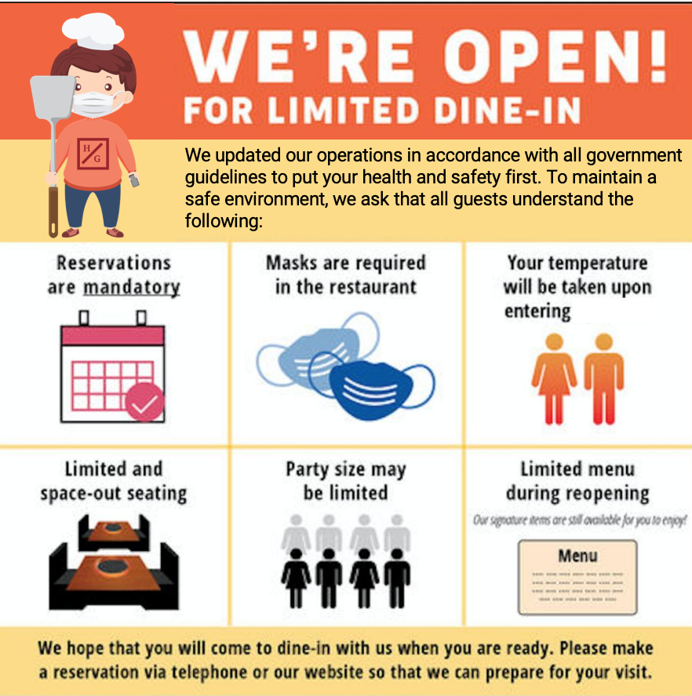
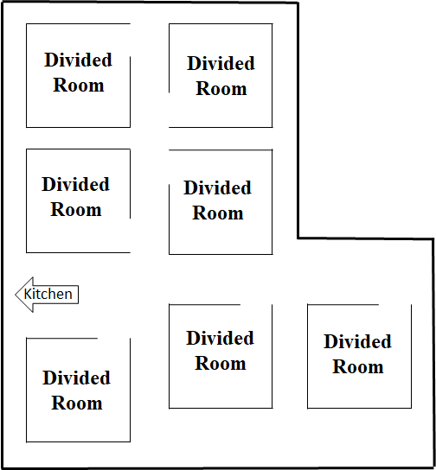
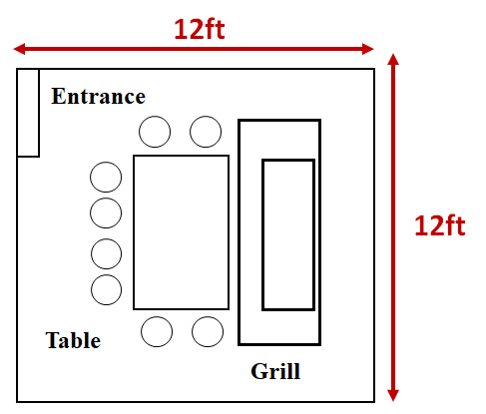


Restaurant reopening plans in accordance with all government regulations and with an emphasis on safety
Re-Opening
Friendly Health Communication
Private Rooms
Let me tell you about myself!
Experienced teppan-chef
Follows
safety protocol
Longer spatula
Digitally native
Bachi
Bachi the Hibachi Chef is a friendly and warm character, symbolizing our renovated brand and values. Bachi will be included in our communication about safety regulation to make the content more engaging. By personifying our restaurant with a character, our consumers can better identify our brand. (See appendix for detailed health and safety protocol)
Exclusive atmosphere while promoting health and safety. Each room includes a private grill and glass barrier around the grill for extra protection. The room is complete with Japanese art dividers.
Notes:
helen

Slide 8
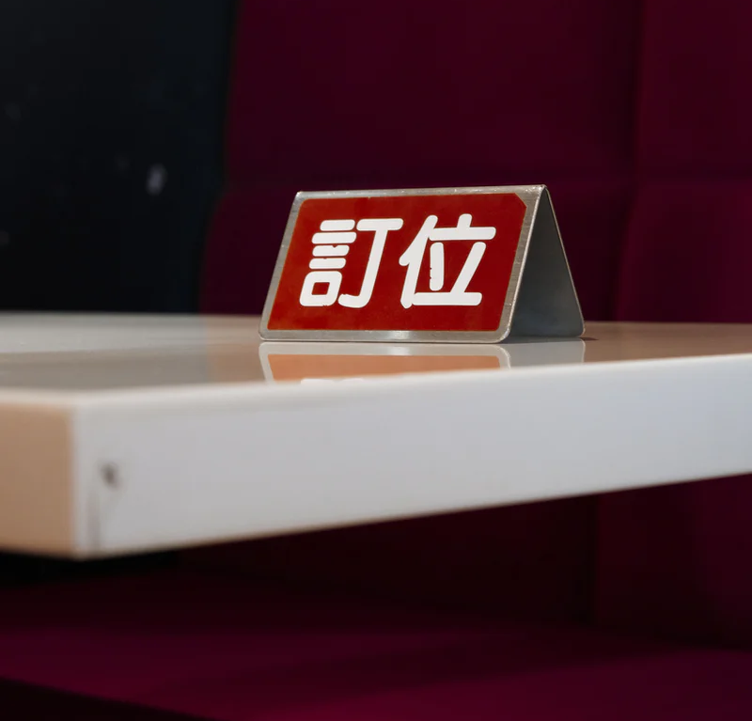
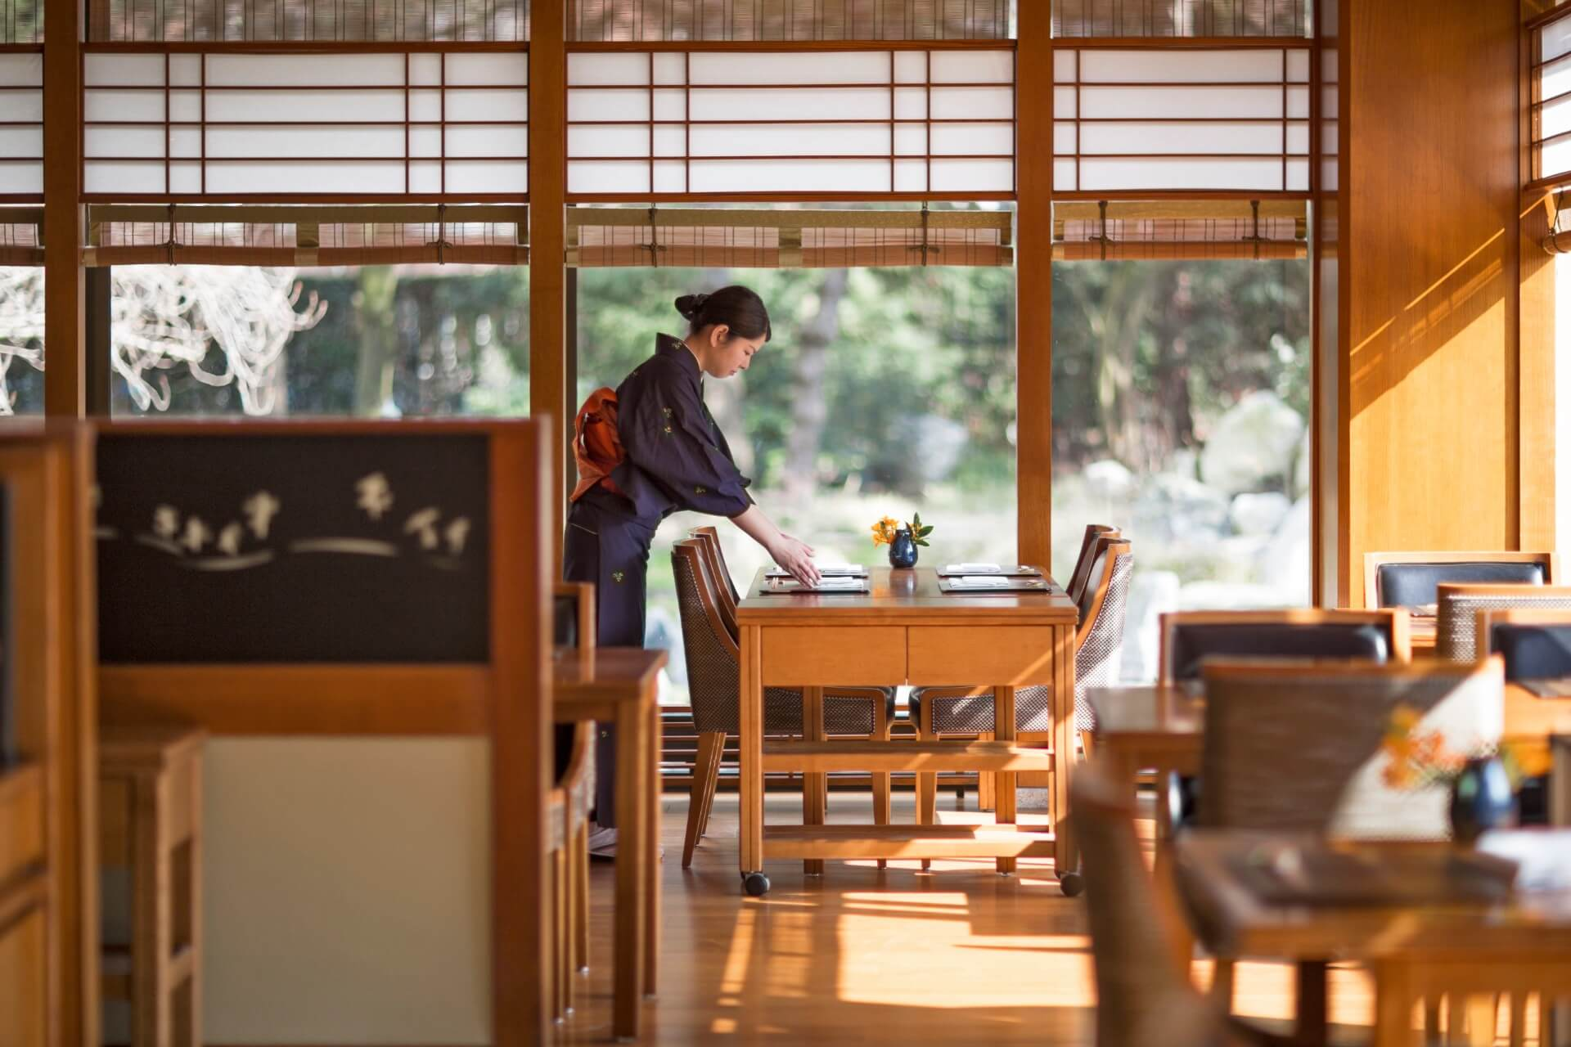
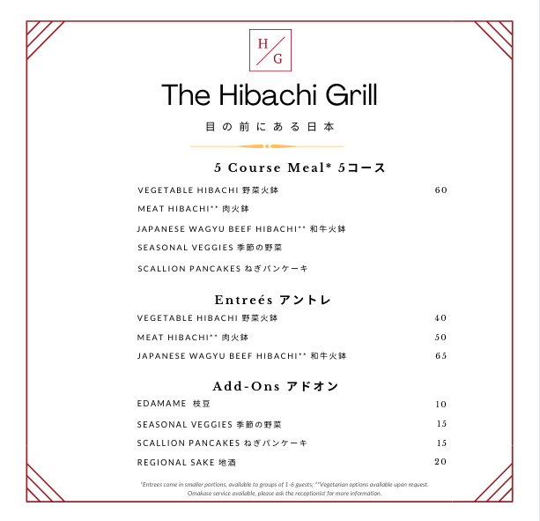
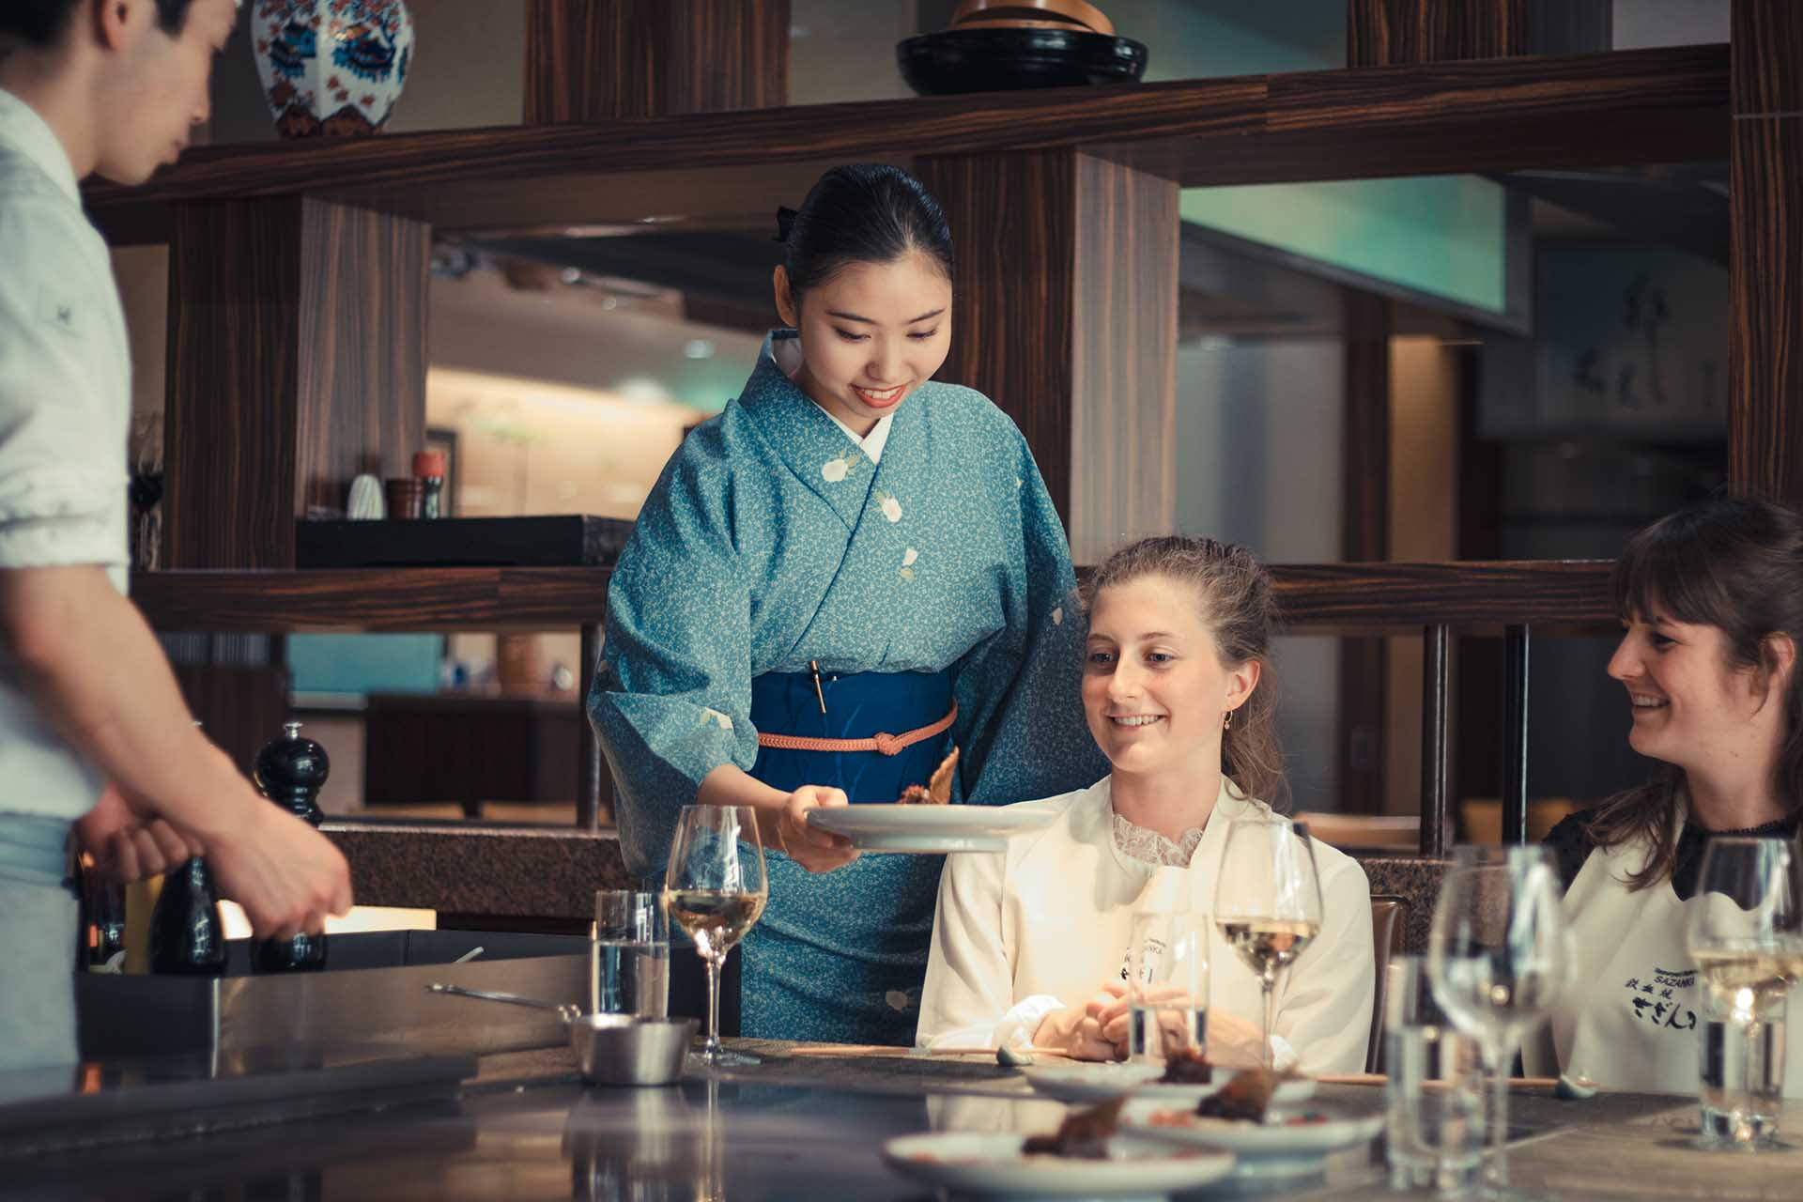
New dine-in operations focused on quality, experience, and high safety measures
Re-Opening
Reserve
Check-In
New Menu
Experience
Given the uncertainty of COVID-19, in order to mitigate reopening risks, guests must make reservations in advance. This system will also help us assess demand and optimize our operations.
Upon arrival, hand sanitizer will be provided to guests at the entrance. Guests must wear masks until seated. Contact information will be asked for contact tracing purposes.
Our simplified menu in Japanese and English will bring you the authentic teppanyaki experience. Due to COVID-19 precautions, sushi has been removed temporarily.
All employees will self-assess for symptoms daily, complete hourly temperature checks, and training for disease prevention. Public transit is discouraged and chefs will use 5 ft spatulas to serve food.
Notes:
helen

Slide 9




People Over Profit: investment in restaurant talents and advancing career opportunities
Culture
Past employees will be given priority consideration for future positions, ideally returning to full employment levels by late Fall 2020. To further show commitment to the employees, we recommend the owner to allocate her own salary to help her laid-off employees.
Professional training will be available to prepare chefs for omakase services. We will allocate up to $8000 per month to finance the training costs, provide in-training chefs with a weekly stipend. Upon reopening, dine-in chefs will also receive a salary increase by $4/hr.
To ensure that all of our employees can arrive to work safely, we will provide carpool, housing stipends, and COVID-19 hazard pay to alleviate our employees’ stress in transitioning during this difficult time.
To help our team build and stay connected during the COVID era, we will implement all expenses paid omakase practice sessions at employees’ homes, weekly virtual happy hours, and weekly virtual mental health support groups.
Communication
Career Advancement
Employee Benefits
Team Building
Notes:
helen

Slide 10
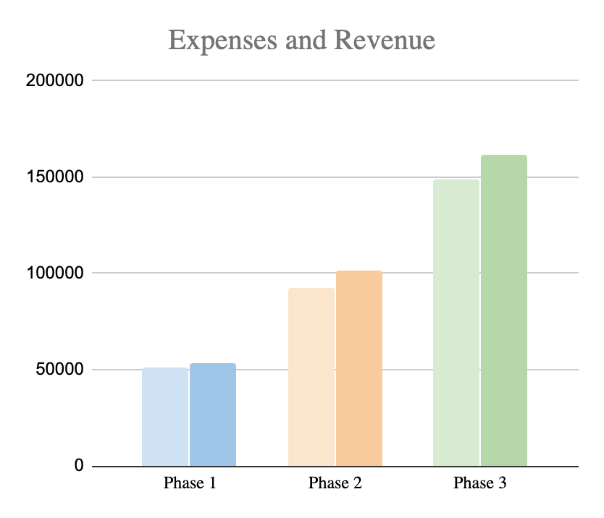
Financial Strategy: maximize synergy and minimize risks
Financials
Number of Employee Shifts
Profit Projections
Expense and Revenue
Profits scale and accumulate as phases progress.
Net Profit margins for each phase will vary around 2% to 6%, as expected for the dining industry
Chefs
Waiters
Delivery Drivers
Chefs-In-Training
E R E R E R
Financial Analysis
Assumptions
Synergy
Monthly Fixed Cost of up to $16,300 for rent and utilities.
Number of shifts will be scaled based on customer demand.
Omakase break-even refers to being able to pay all chefs a minimum of $400 weekly.
In phase 3, chefs who are trained for Omakase can operate in dine-in settings as needed.
The simplified menu can also be optimized to create an economy of scale via better supply chain efficiencies.
Daily Delivery/Takeout
Weekly Omakase
Daily Occupancy
19
30
19
6
30
30
19
6
60%
30
30
75%
Phase 1
Phase 2
Phase 3
Break Even
Projected
Notes:
xyz

Slide 11
Ensuring sustainable future growth: implementation timeline, risks, and mitigation
Operations
Important Dates
Phase 2: Omakase Preparation Completed
Phase 3: Philadelphia Restaurant Restrictions Lifted
Probability of Risk Occurring
Low
High
Implementation Timeline
Activity | Phase 1 | Phase 2 | Phase 3
 | Aug - Sept. 2020 | Sept - Fall 2021 | Fall 2021 +
Website Design + Launch
Delivery/Pick-Up Service
Chef Enrichment Program
Omakase Service
Employee Housing Subsidy
Menu Redesign
Other Rebranding Initiatives
Dine-In Renovations
Dine-In Service
Low
C
E
Severity of Risk
D
High
B
A
A
Higher Rent/Utilities Than Expected
Lower Delivery Demand Than Expected
Lower Omakase Demand Than Expected
Lower Dine-In Demand Than Expected
Longer Restrictions Period Than Expected
B
C
D
E
Phase 1
Phase 2
Phase 3
Notes:
xyz

